Slide 1
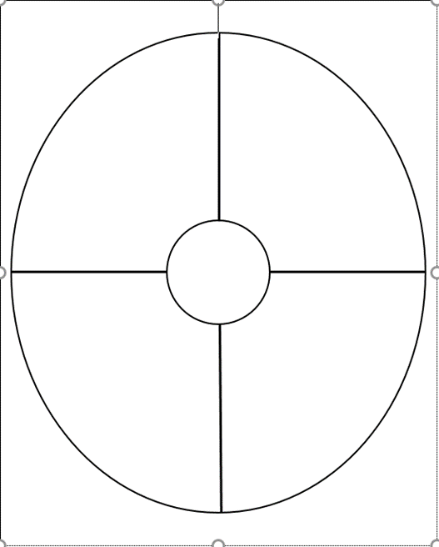
Definition
Image/ Illustration
Definition
Image/
Illustration
#
#
Sentence
Sentence

Slide 2
Definition
Image/ Illustration
Definition
Image/
Illustration
#
#
Sentence
Sentence

